Slide 1
CareConnect – Elderly Care Coordination Platform
CP5307 – Assessment 1 (Part B) – Code Review Presentation
James Ross (14472266)
June 2025

Slide 2
Agenda
Problem Statement
Target Audience
Competitor Analysis
Proposed Features
Mockup of Screen Designs
Development Timeline
Version Control Strategy

Slide 3

Problem Statement
Scenario 2: Elderly Care Coordination Platform
Coordination Difficulties: Medications, appointments, routines across multiple family members.
Consequences: Confusion, missed appointments, stress, potential risks.
The Challenge: Coordinating Elderly Care
The Opportunity: Mobile application that streamlines caregiving duties.

Slide 4
Target Audience
Users: The Caregiving Circle
Primary Caregivers (e.g., Mark): "The Organiser"
Needs: Centralised planning, task delegation, oversight, clear communication.
Preferences: Efficient, reliable, comprehensive.
Behaviours: Frequent app usage, needs quick access to critical info.
Secondary Caregivers (e.g., Siblings, Aides): "The Supporters"
Needs: Stay informed, view schedules, contribute to tasks, report observations.
Preferences: Easy to access, clear updates, simple interface.
Behaviours: Intermittent app usage, focused on specific information or tasks.

Slide 5
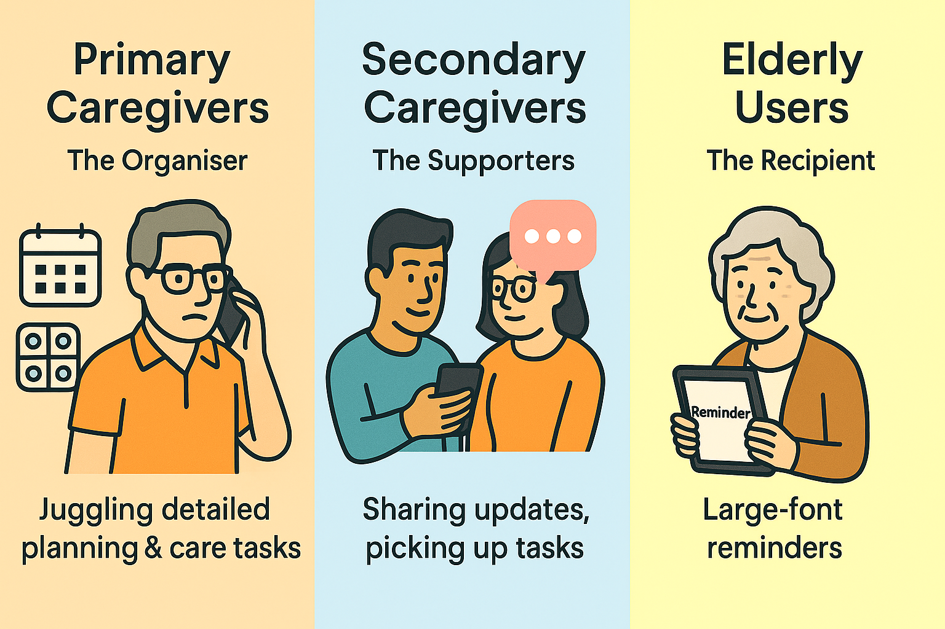
Target Audience cont.
Elderly Users: "The Recipient"
Needs: Simple reminders (if capable), feeling connected.
Preferences: Very large fonts, high contrast, minimal complexity.
Behaviours: Limited interaction, primarily passive information reception.
Figure 1: Target Audience and Personas

Slide 6
Competitor Analysis
Identified gap – Healthcare focus with group coordination
Table 1: Related Apps – Strengths, Weaknesses, and Differentiation

Slide 7
Proposed Features
Scheduler:
Medication Scheduler: Create/edit medication entries (name, dosage, frequency), and specific instructions. Automated reminders with snooze and confirm. Log for tracking administration (who gave it, when, any notes/side effects).
Appointment Manager: Shared calendar for doctor’s appointments, therapy sessions etc. Push notifications and calendar integration (Google/Outlook). Ability to add appointment details (specialist, location, purpose, notes, questions to ask). Reminders for upcoming appointments for relevant caregiver.
Shared Calendar & Timeline View: Consolidated timeline of all care activities. Color-coded by activity type or caregiver.
Daily Routine Tracker (optional): Possible incorporated into Journal. Log meals, fluid intake, hygiene, sleep patterns, exercises, mood checks. Quick entry for common routines. Notes section for observations or incidents.

Slide 8
Proposed Features
Real-Time Communication: In-app messaging or shared family noticeboard for updates. Centralised “Care Journal” for important updates, observations, and progress notes accessible to all approved roles. File/photo sharing for documents (prescriptions, reports. ). Push notifications for critical updates.
Emergency Information: Quick access to vital information such as emergency contacts, list of allergies, primary doctor’s details, and key medications.
Emergency Alerts: One-touch “I need help” button notifies all caregivers.
Accessible Design: Dashboard Home Screen, Tabbed Navigation, and Notification Centre. Will also include legible fonts, high contrast options, and simple navigation.

Slide 9
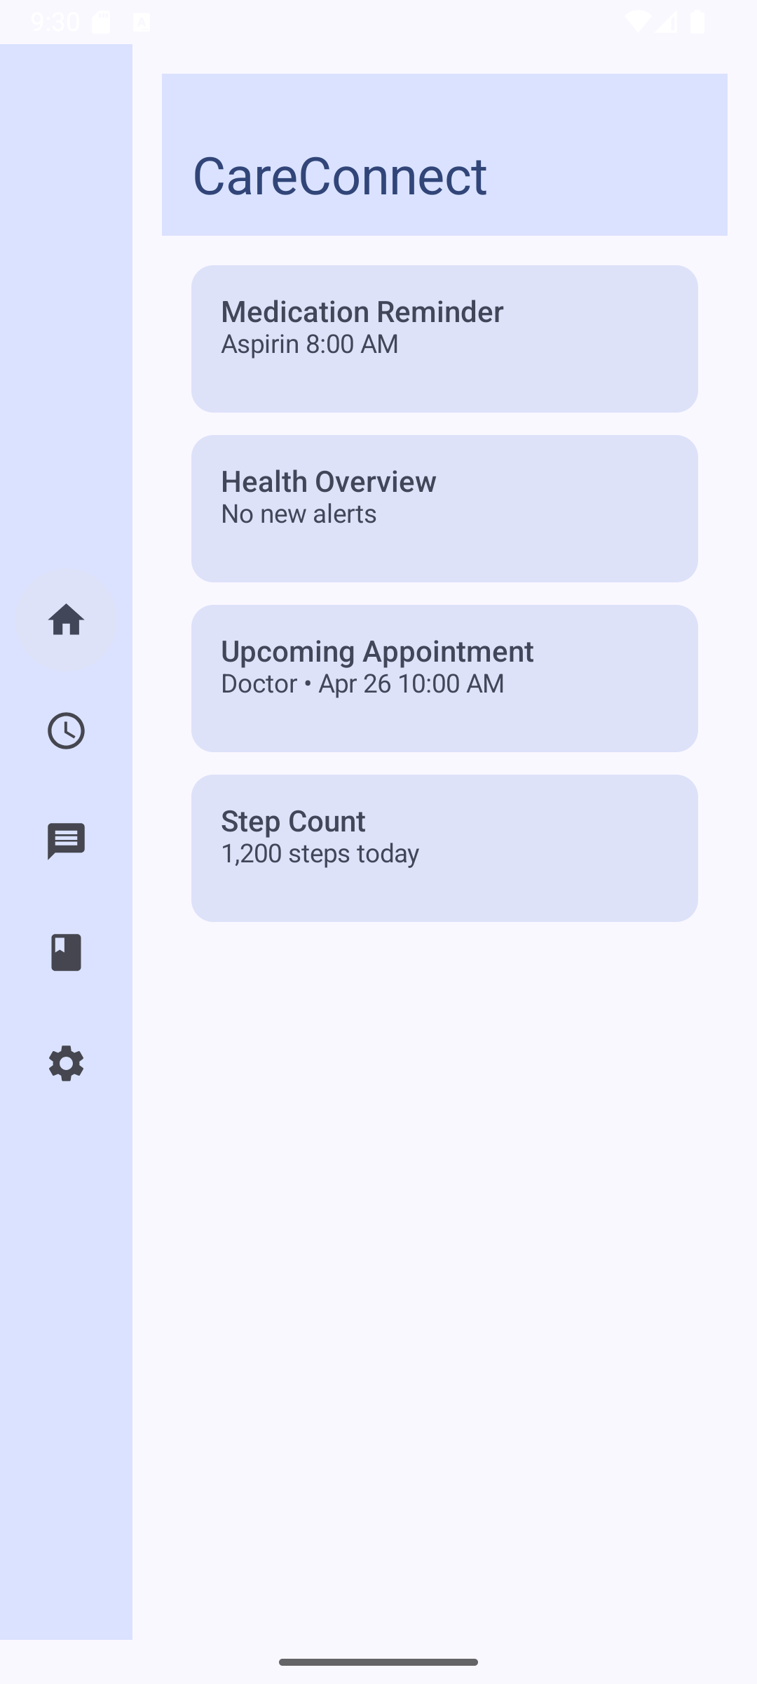
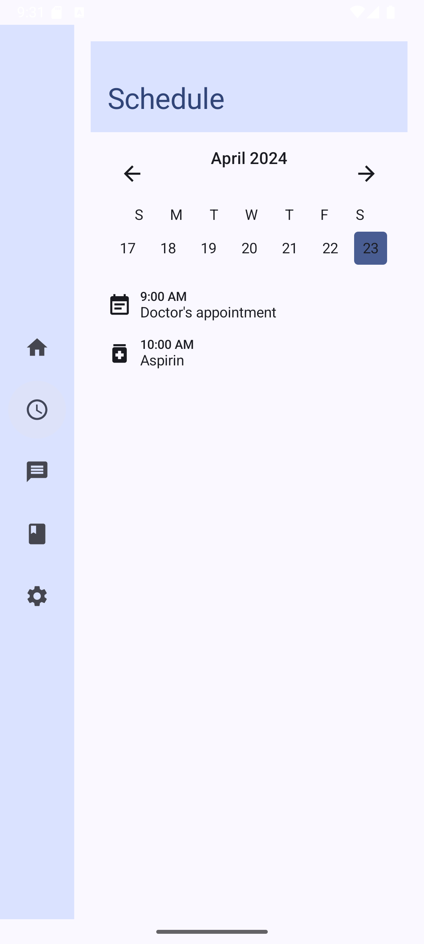
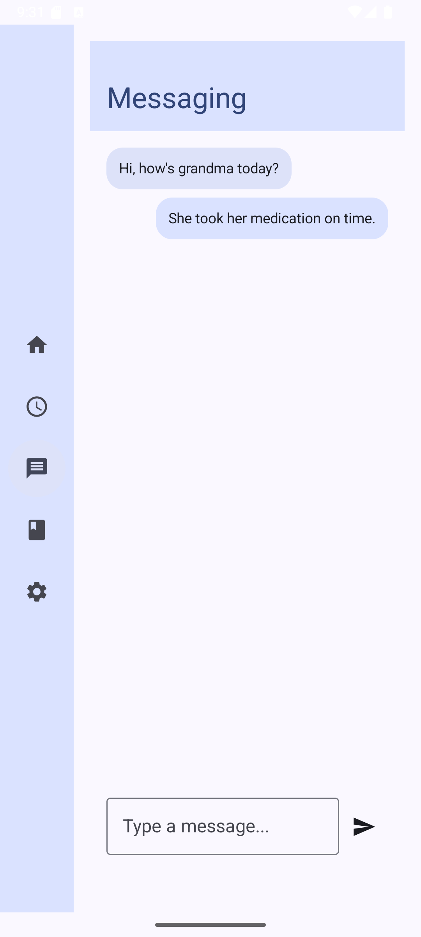
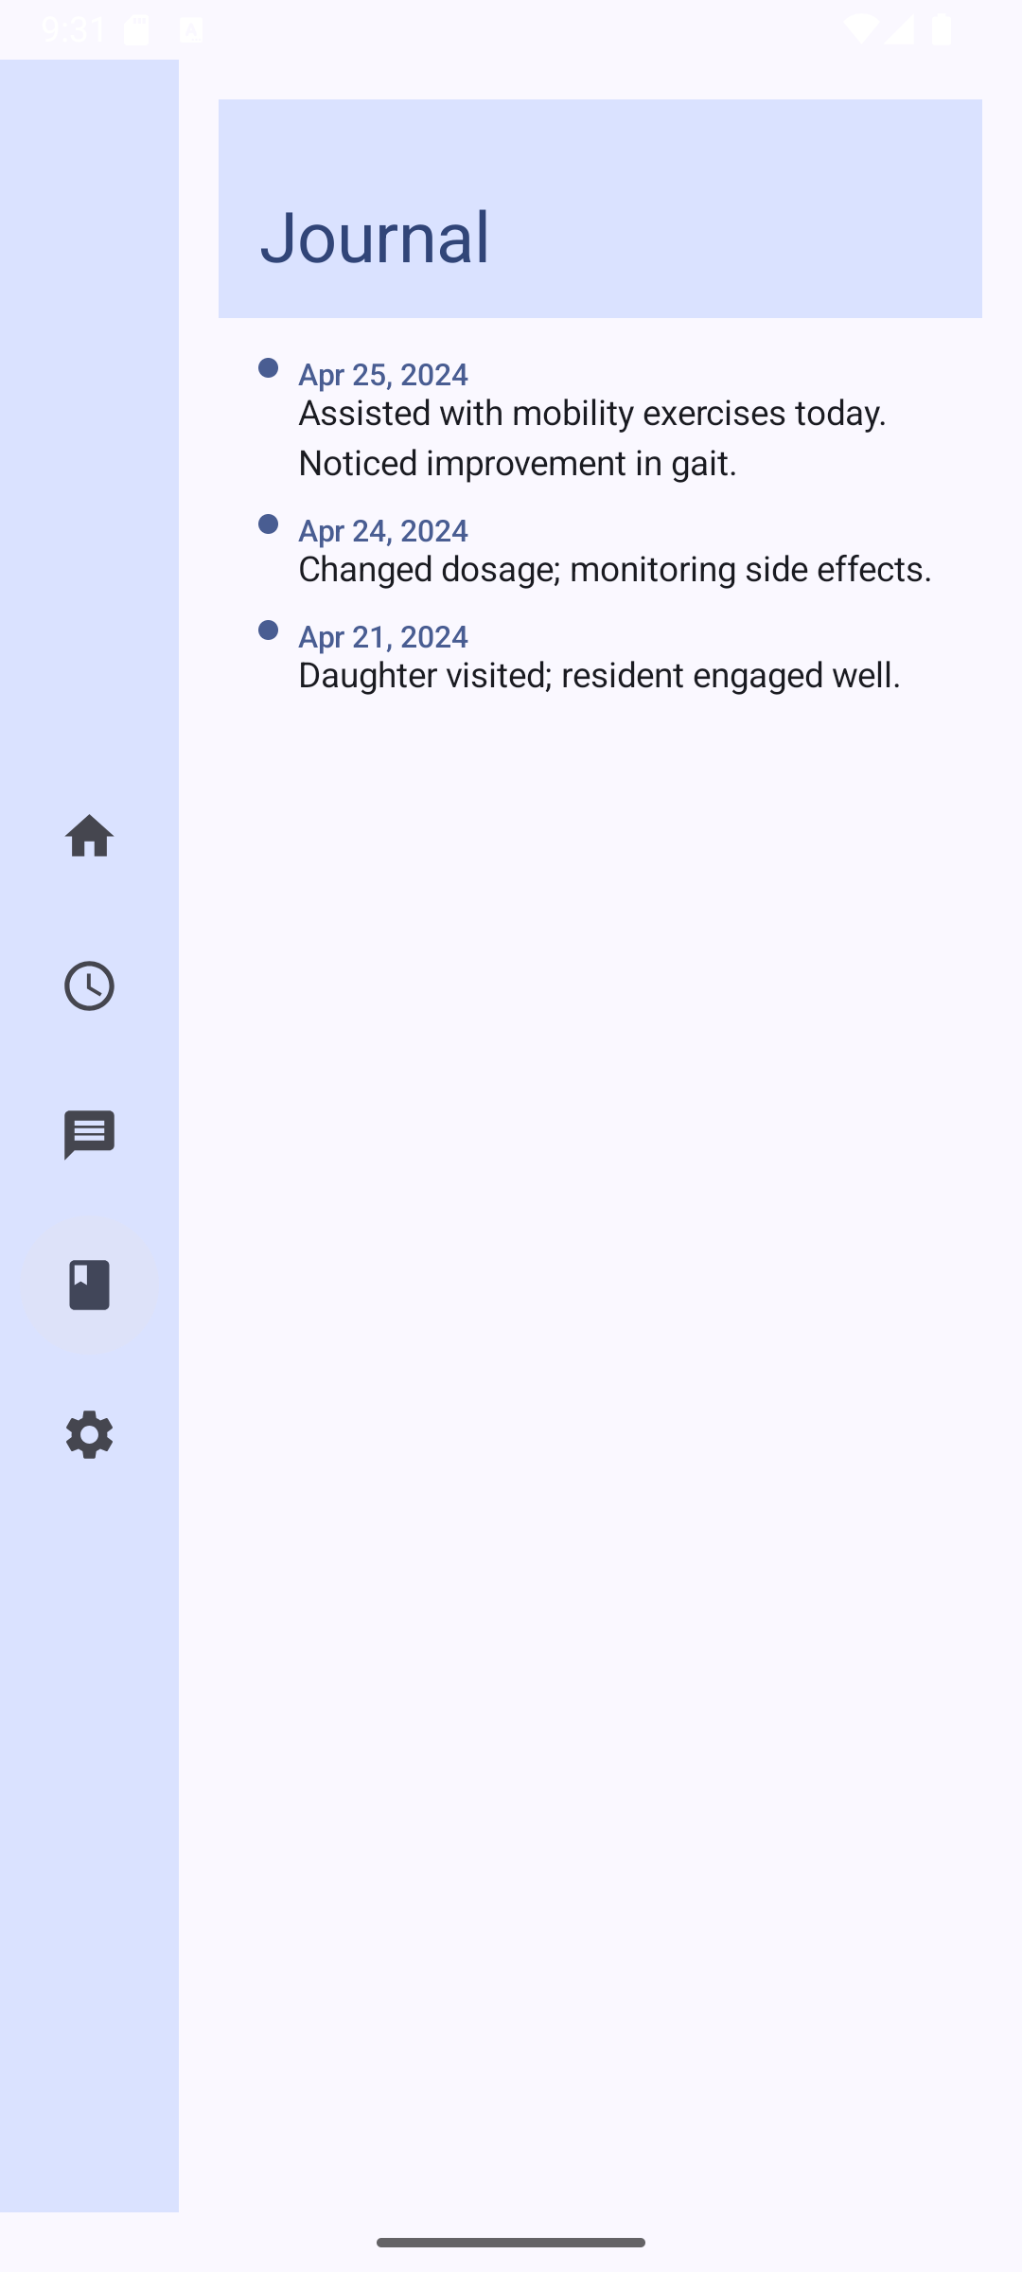
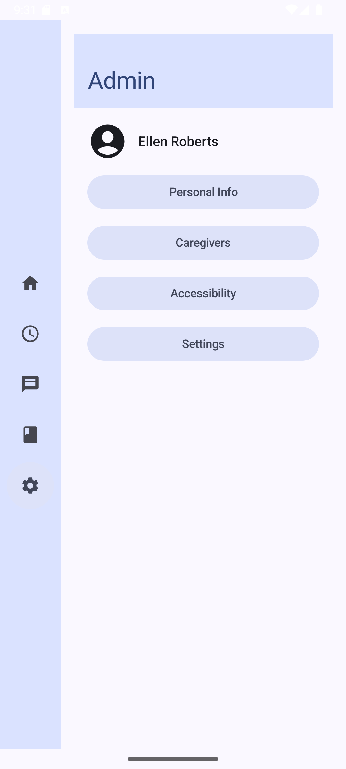
Mockups of Screen Designs
Layout Designs using Jetpack Compose
Figure 2.1 - Dashboard
Figure 2.2 - Schedule
Figure 2.3 - Messaging
Figure 2.4 - Journal
Figure 2.5 - Admin
Figure 2: Layout Designs using Jetpack Compose

Slide 10
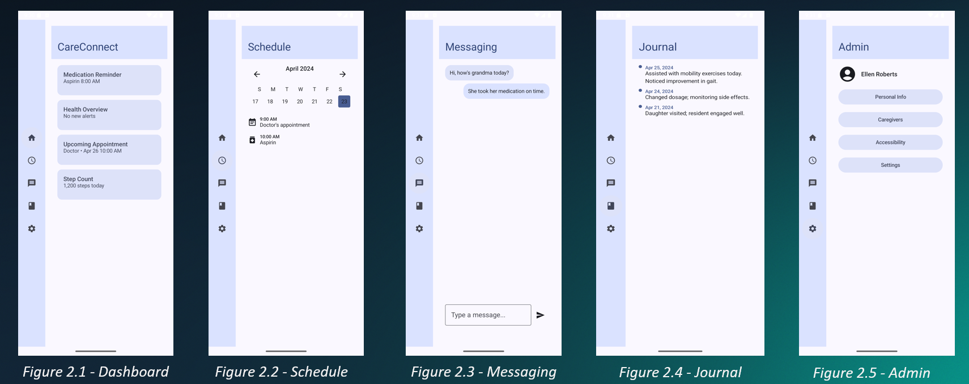
Mockups of Screen Designs Cont.
Scaffold & Custom Theme
Screen Containers
Navigation Rail for ease of User Flow
Main functions categorised by screen
Challenges:
Accessibility vs Density
Missing Features in Jetpack
Complex Layouts
Complexity of Considerations
Figure 2: Layout Designs using Jetpack Compose

Slide 11
Development Timeline
Key Milestones:
Detailed Wireframes
MVP (Medication & Appointments functional)
Beta (Core Features testable)
Final App
Project Management:
Agile-inspired (sprints/weekly goals)
Regular Self-review
Task Breakdown
Table 2: Development Timeline

Slide 12
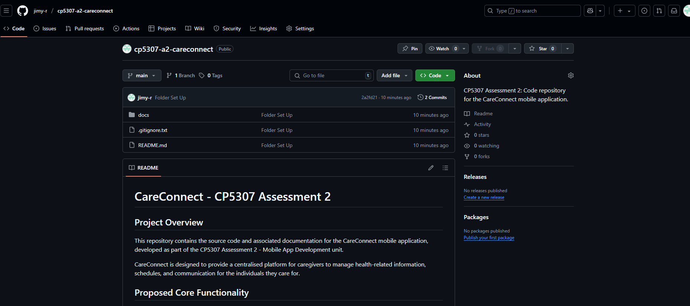
Version Control Strategy
Centralised Repository
GitHub Link: https://github.com/jimy-r/cp5307-a2-careconnect
Branching Strategy:
Main Branch
Development Branch
Feature Branches
Commit Practices
Figure X: GitHub Repository

Slide 13
Conclusion
Aim for CareConnect to be a comprehensive, intuitive and reliable Android application.
Seek to address specific needs of elderly care coordination.
Potential to reduce caregiver stress, improve family communication, and enhance safety.

Slide 14
Thank you for listening.

